Slide 1
Chapter 21

Slide 2
Objectives

Slide 3
Objectives (cont.)

Slide 4
The package that contains the JDBC interfaces and classes

Slide 5
The four types of JDBC database drivers (cont.)

Slide 6
A URL for downloading a JDBC database driver for SQLite

Slide 7
How to make a database driver available to an application

Slide 8
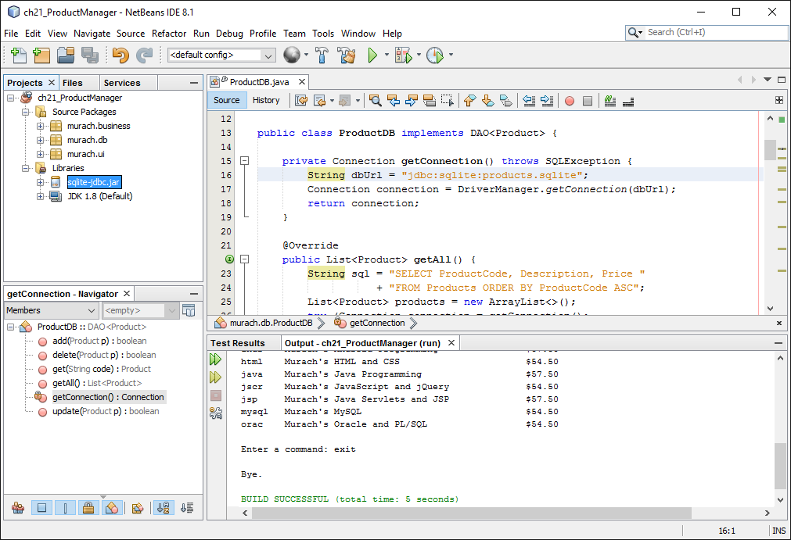
A project with a JDBC database driver for SQLite

Slide 9
Database URL syntax

Slide 10
A method that connects to a MySQL database that’s running on a server

Slide 11
How to load a database driver prior to JDBC 4.0

Slide 12
Two methods of a ResultSet object

Slide 13
How to move the cursor to the first row in the result set

Slide 14
Methods of a ResultSet object that return data from a result set

Slide 15
Code that creates a Product object from the products result set

Slide 16
How to use the executeUpdate() method

Slide 17
How to use the executeUpdate() method (cont.)

Slide 18
Warnings for using the Statement object

Slide 19
How to use a prepared statement

Slide 20
How to use a prepared statement (cont.)

Slide 21
The DAO interface

Slide 22
The ProductDB class

Slide 23
The ProductDB class (cont.)

Slide 24
The ProductDB class (cont.)

Slide 25
The ProductDB class (cont.)

Slide 26
The ProductDB class (cont.)

Slide 27
The ProductDB class (cont.)

Slide 28
The ProductDB class (cont.)

Slide 29
How to import the business and database classes

Slide 30
How to add a product

